Slide 1

Presentation on Placement Management System
UNDER THE GUIDENCES of
Prof CHITRaNJAN
Technical Trainer
Edubridge
(School of coding)
SUBMITTED BY
Anupama Narasappa
B Tech
Batch:EON-5759
Center: Thane

Slide 2
ABSTRACT
Placement Management System (PMS) is web-based tool to reduce communication gap between Job providers and Job seekers. The Main objective of this solution is to make easy the recruitment process of any organization. This PMS is designed by keeping in mind both parties Job providers and Job seekers. PMS allows Job seekers to register their details like skills and experience with the system, and then on the other hand even it allows job providers to post their requirements with the system. Placement Management System is helpful for the job providers i.e. companies which are in need of employees, job seekers who are in need of job, (for both Experienced and fresher’s). This portals main aim is to provide the vacancies available for the job seekers without taking any charge from them in IT technologies. PMS will automatically send mails to all job seekers whose skills are matched with the requirement.

Slide 3
INTRODUCTION
The Project titled “Placement Management System ” is one which helps out the HR Personal in the recruitment of new candidates to the company and helps the recruitment process as a whole.
A college Placement Management System that consists of a student login, company login and an admin login.
The project is beneficial for college students, various companies visiting the campus for recruitment and even the college placement officer.
The software system allows the students to create their profiles and upload all their details including their marks onto the system.
The system handles student as well as company data and efficiently displays all this data to respective sides.

Slide 4
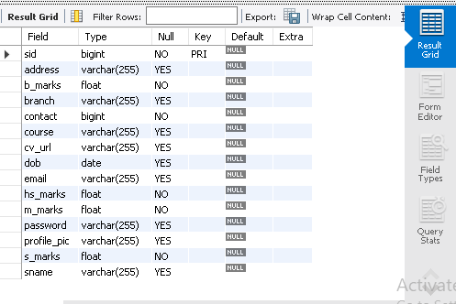
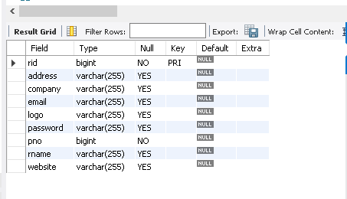
Data Dictionary Student database RECRUITER DATABASE

Slide 5
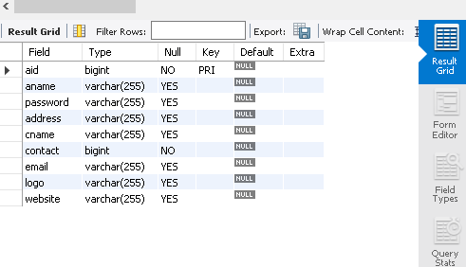
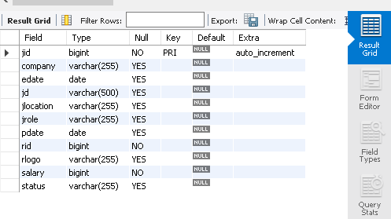
Data Dictionary ADMIN database JOBS DATABASE

Slide 6
System requirements
Hardware Requirement:-
Software Requirement:
i5 Processor Based Computer
1 GB-Ram
5 GB Hard Disk
Monitor
Front End: HTML, CSS, JavaScript, Spring boot
Back End: MySQL workbench8.0.CE
Middleware/Server: Apache Tomcat v.8.5, IDE: Spring Boot
Browser: Google Chrome
Windows10 operating system

Slide 7
MODULE DESIGNED
Home Page
Admin Portal
Recruiter Portal
Student Portal

Slide 8
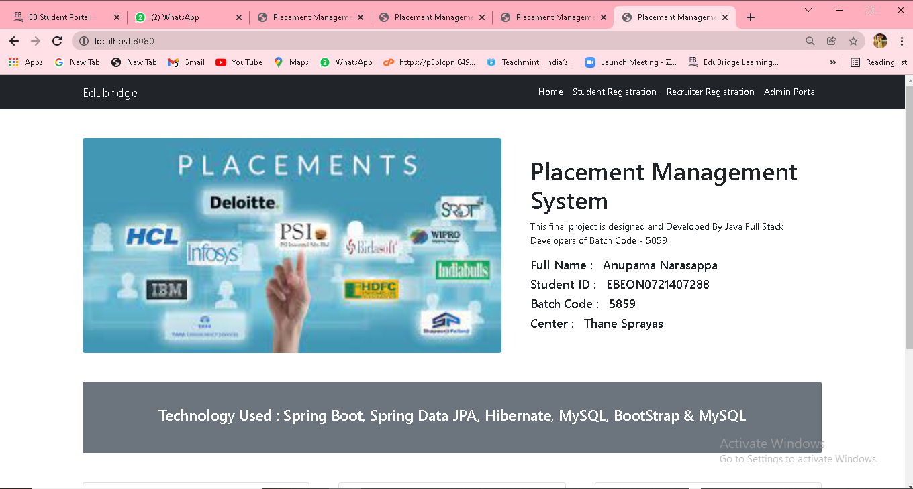
Home page

Slide 9
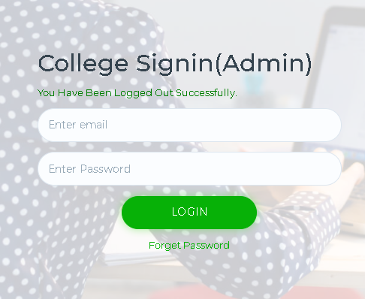
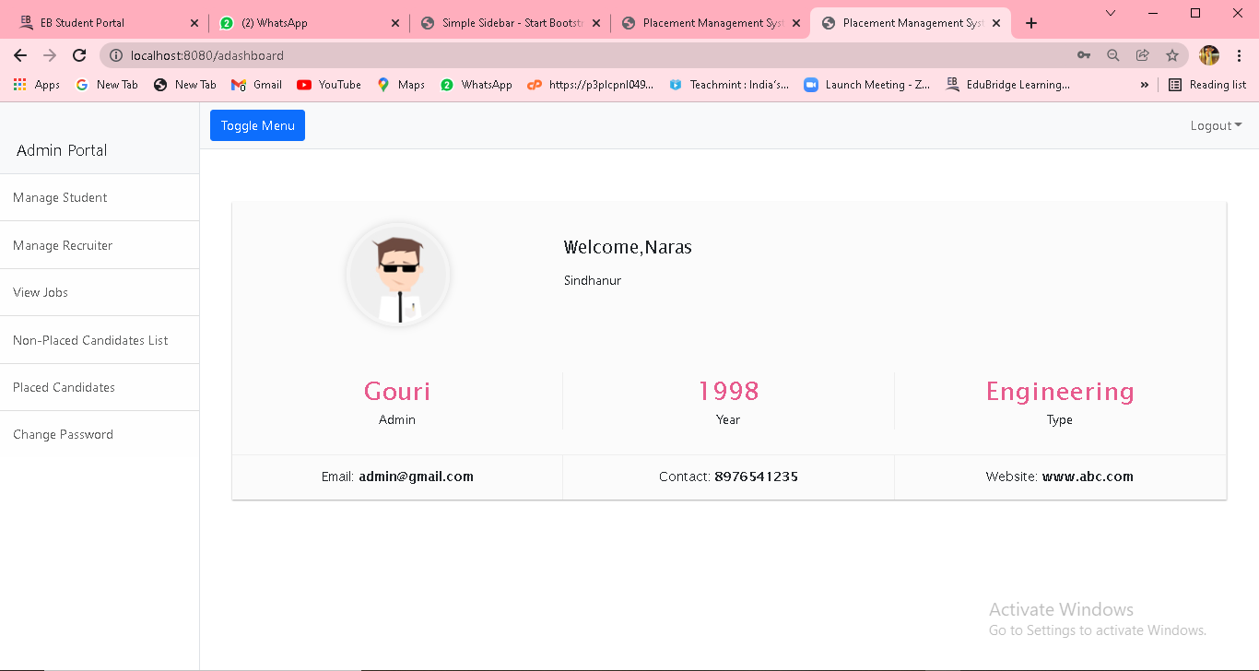
Admin sign-in and admin Portal

Slide 10
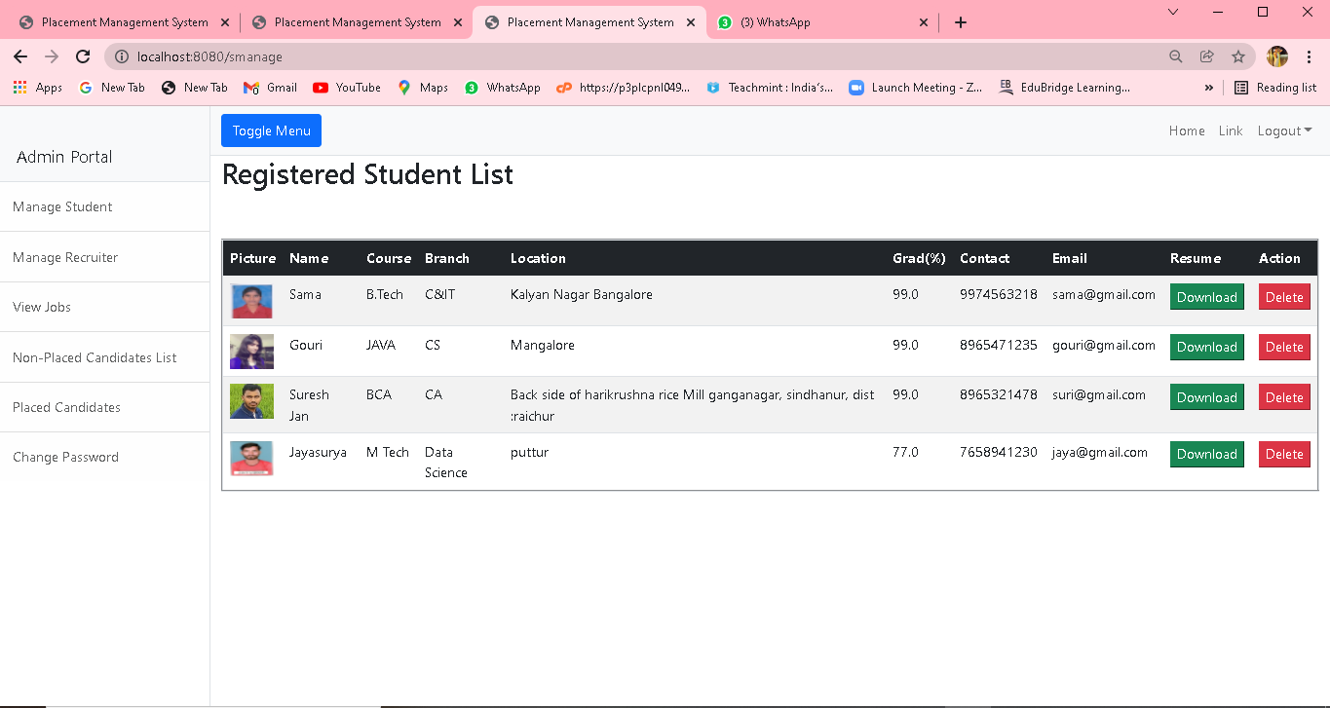
Admin portal Registered STUDENT LIST

Slide 11
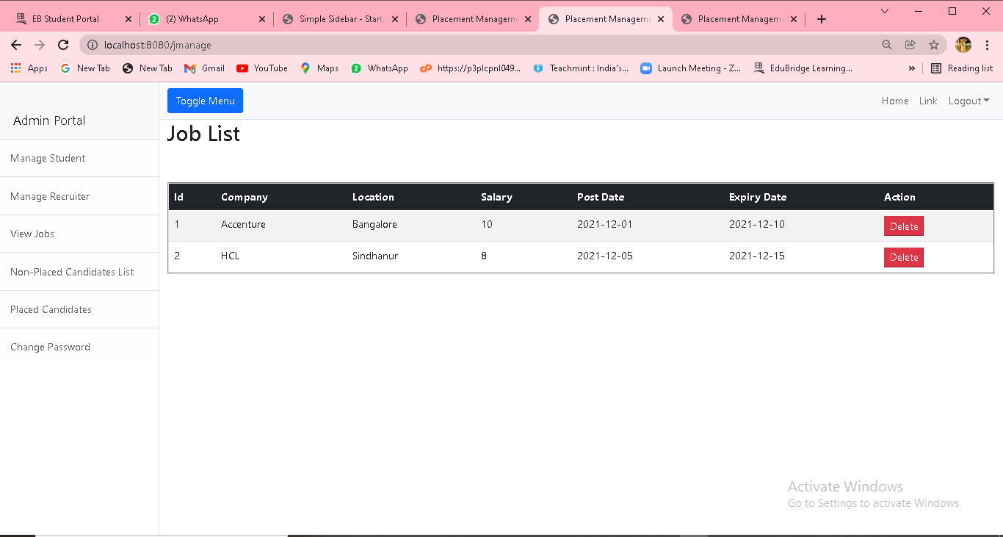
Admin portal job LIST

Slide 12
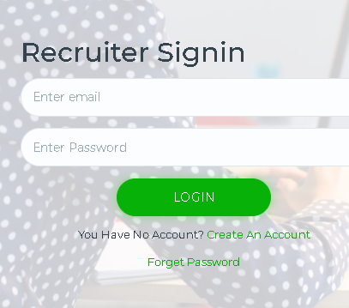
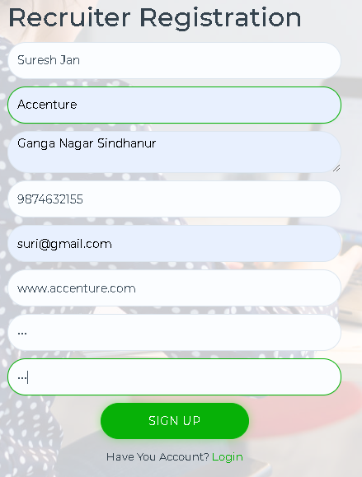
Recruiter sign-in and signup page

Slide 13
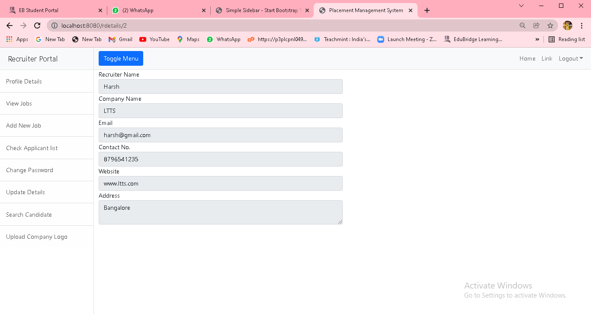
RECRUITER PORTAL Profile details

Slide 14
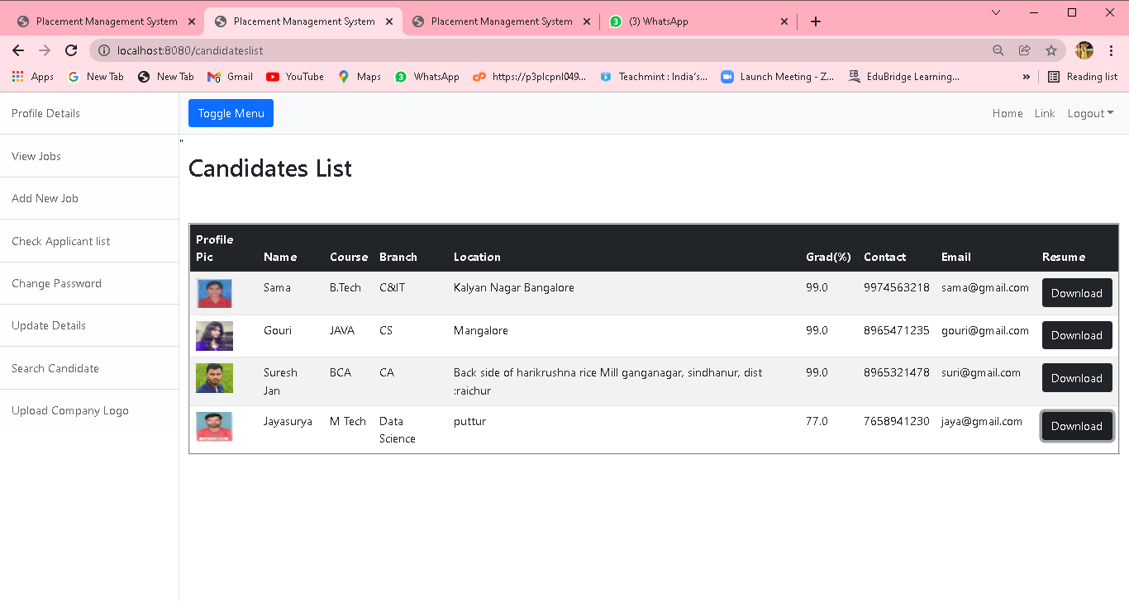
Recruiter portal CANDIDATES LIST

Slide 15
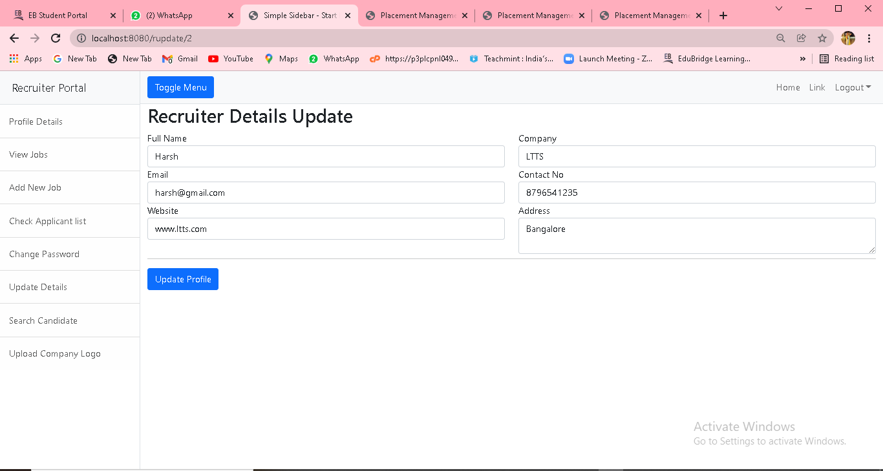
Recruiter portal RECRUITER DETAILS UPDATE

Slide 16
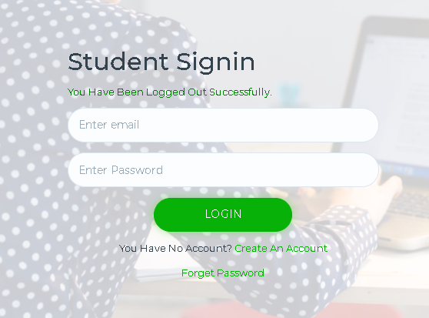
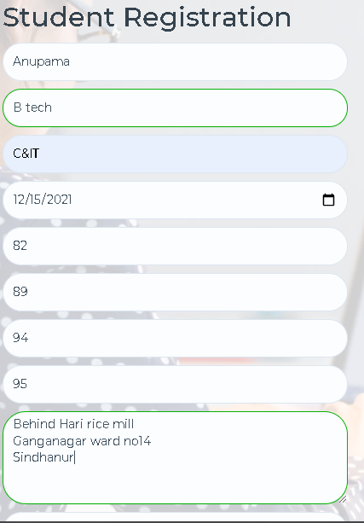
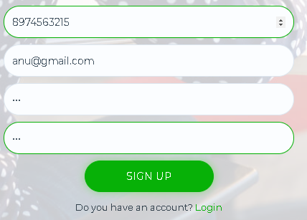
Student sign-in and signup page

Slide 17
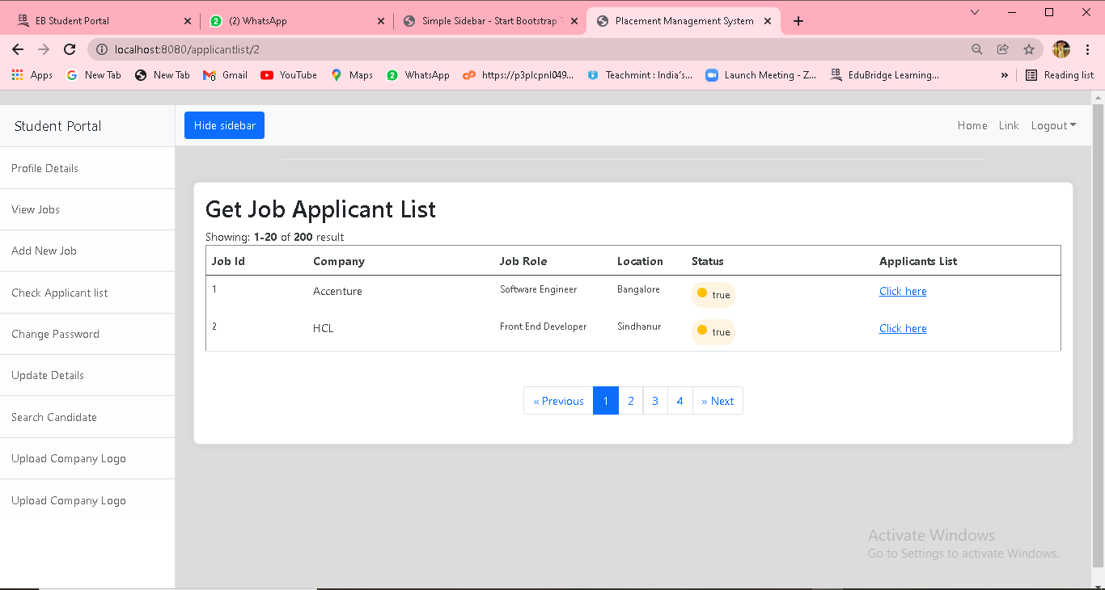
student portal get Job applicant list

Slide 18
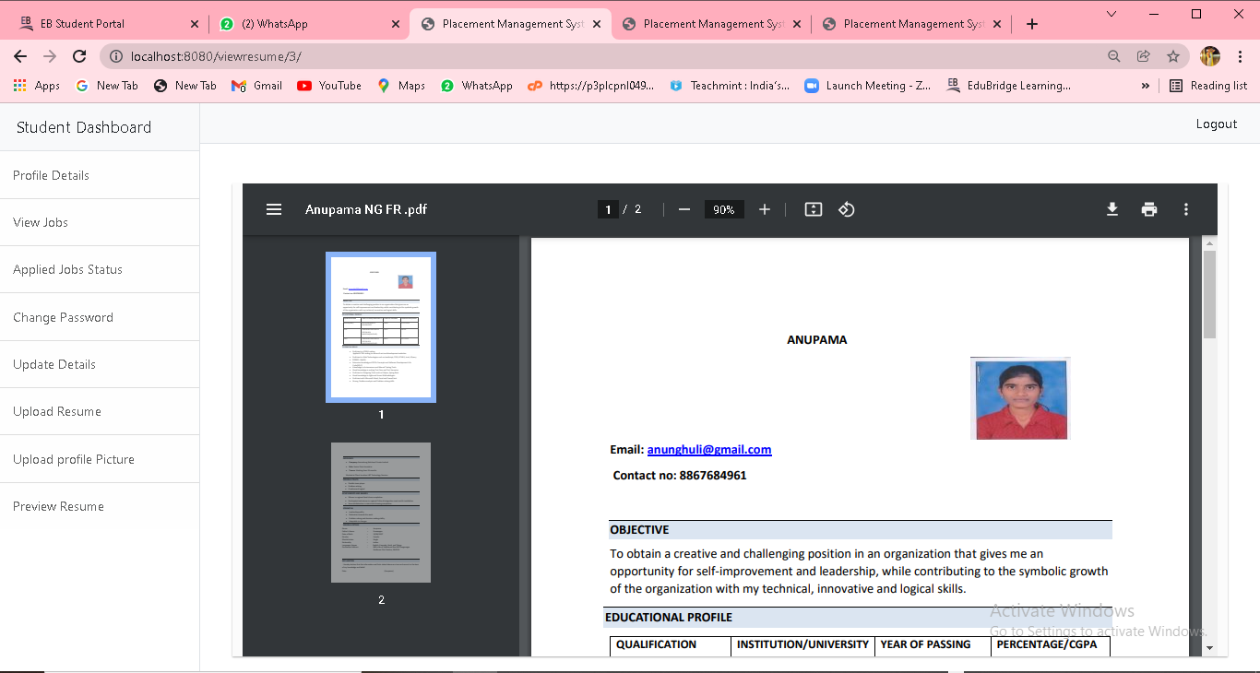
student portal PREVIEW RESUME

Slide 19
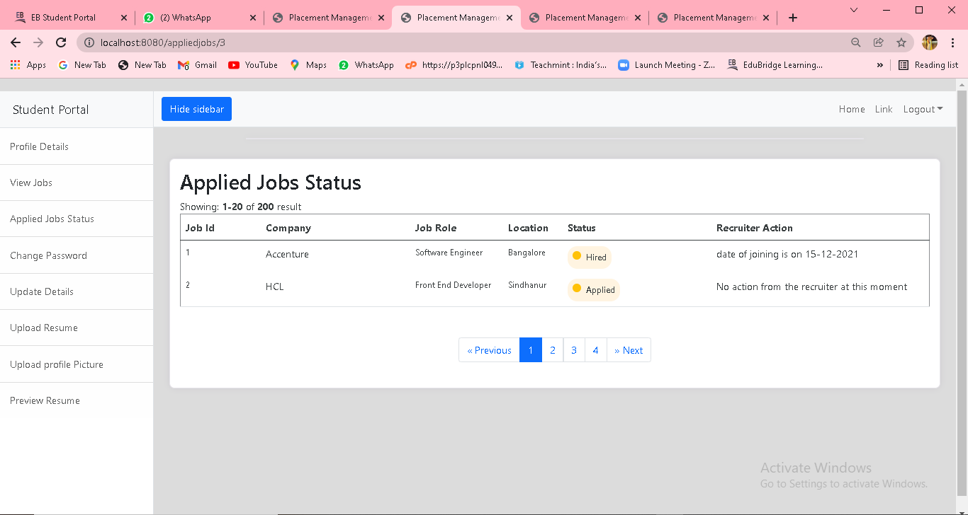
student portal applied jobs status

Slide 20
PROJECT IMPLEMENTATION
Project Implementation Technology:
The Project is loaded in Spring boot. We used Spring Tool Suite 4 for Design and coding of project. Created and maintained all databases into MySQL workbench8.0.CE in that we create tables, write query to store data or record of project.

Slide 21
conclusion
In this presentation, we explained the system design, requirements and implementation and the modules we have done till now. In accessing the outcome of this System, we have come to the final conclusion that online Placement Management system is more convenient than manual Placement Process.

Slide 22
REFERENCES
SOFTWARE ENGINEERING (Roger s. Pressman)
COMPLETE HTML (Steven Holzner)
WWW.W3SCHOOLS .COM

Slide 23
THANK YOU

